Slide 1
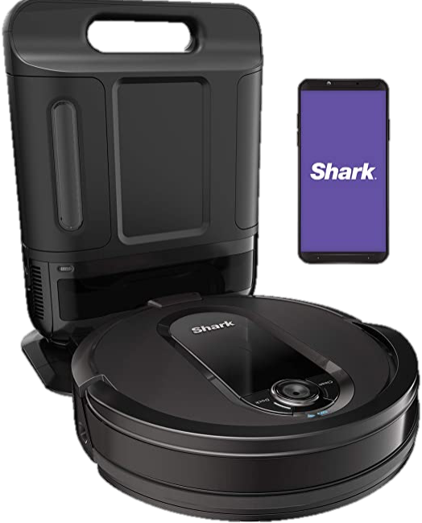

Constant State of Clean™ for your whole home

Slide 2

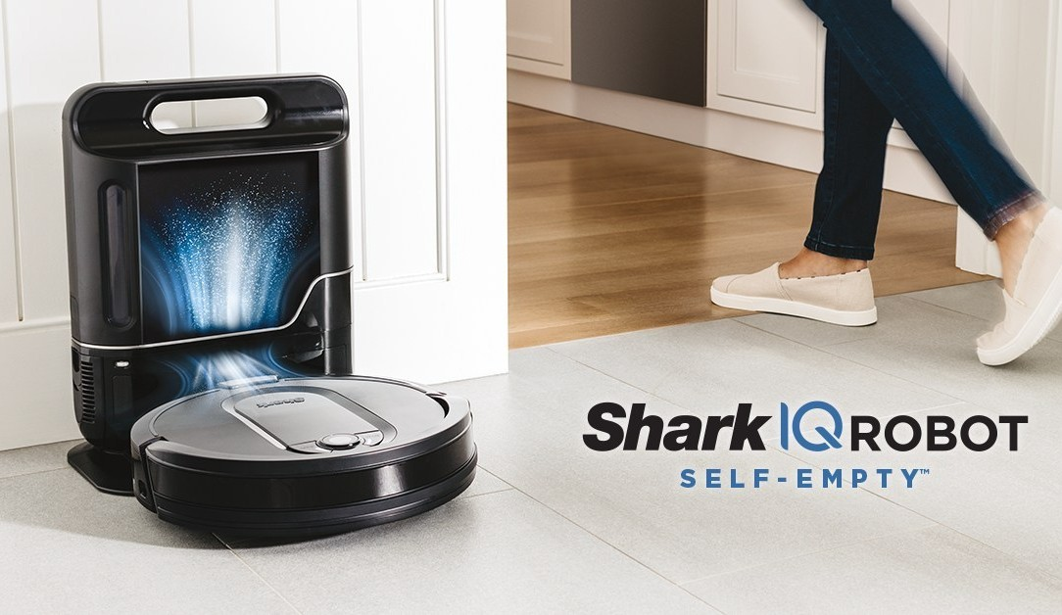
Shark IQ Robot Self-Empty
Bagless Self-Empty Base Powerful Cleaning
Complete Home Mapping Intelligent Cleaning

Slide 3
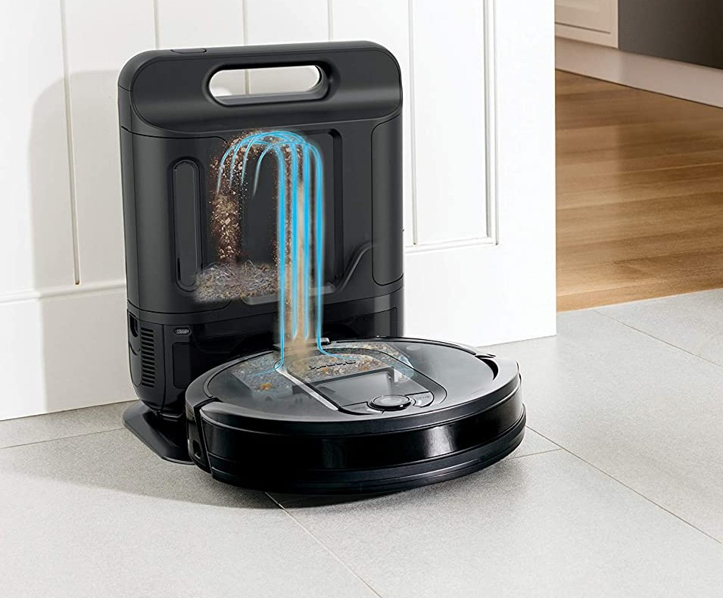

Bagless Self-Empty Base
Holds up to 30 days of dirt and debris.
Forget About Vacuuming Compact Design

Slide 4
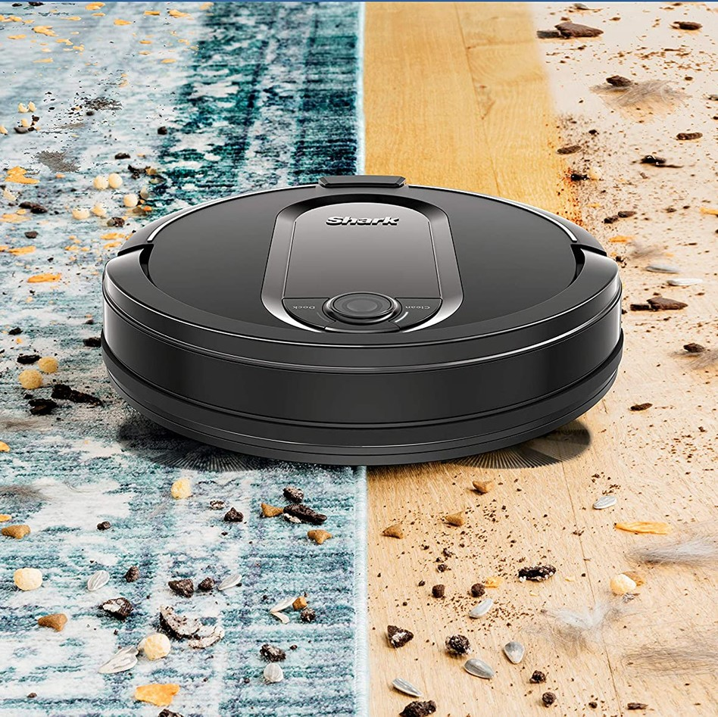
Powerful Suction
Hard Surfaces Carpets

Slide 5
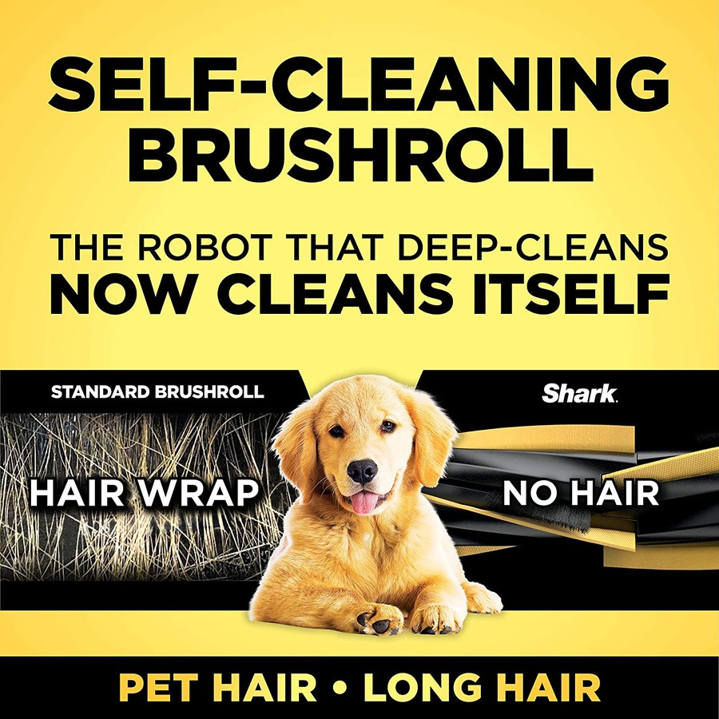
Deep Cleaning
Large Debris Small Debris Pet Hair
No Maintenance Brushroll

Slide 6
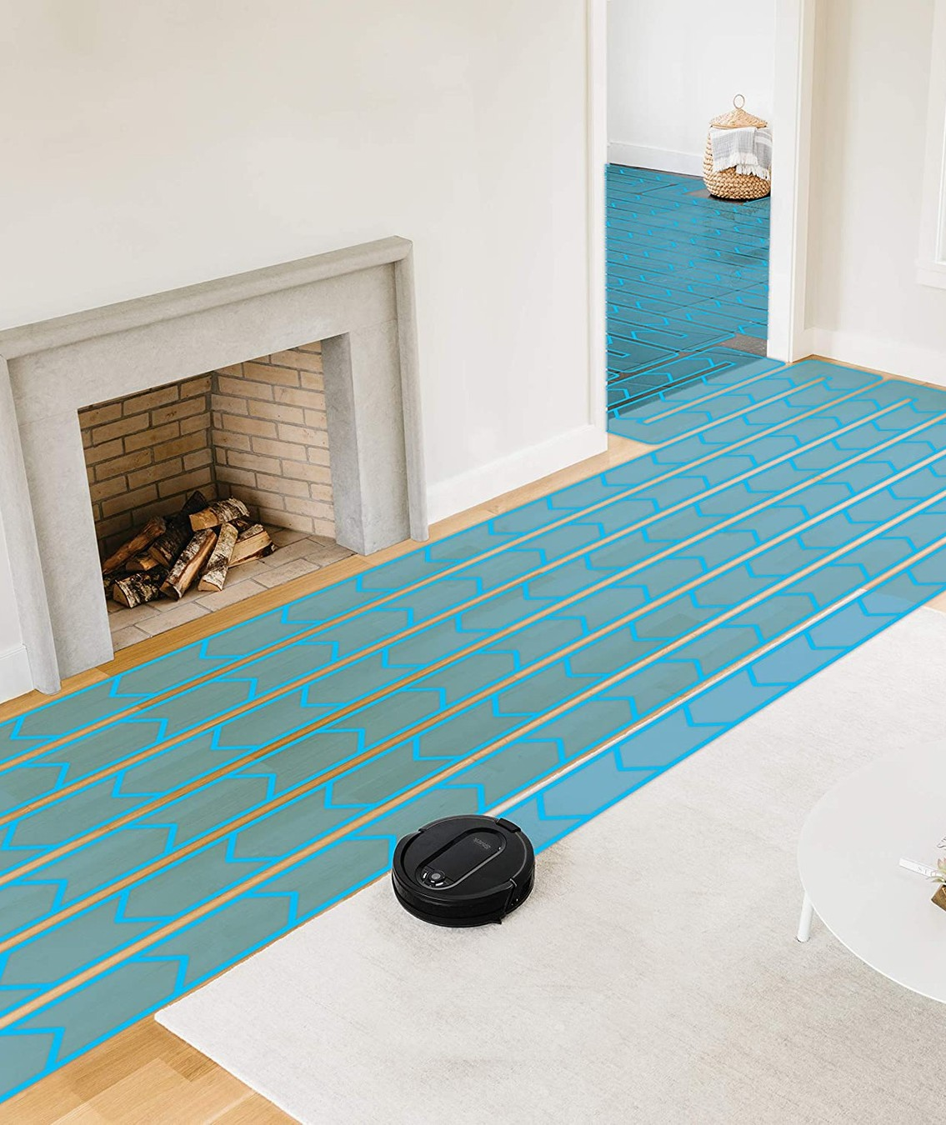
Navigation
Row by Row Cleaning Cliff Sensors
Avoids "off-limits" Areas

Slide 7
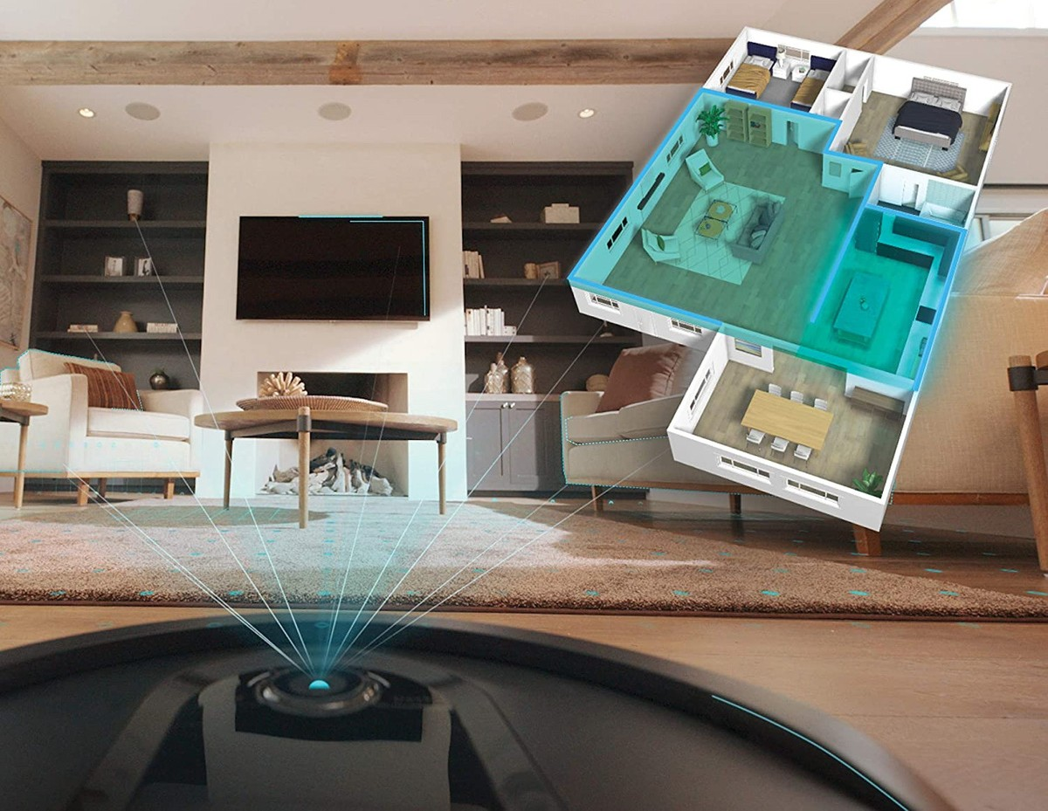

Customized Mapping
Home Mapping Room Targeting

Slide 8
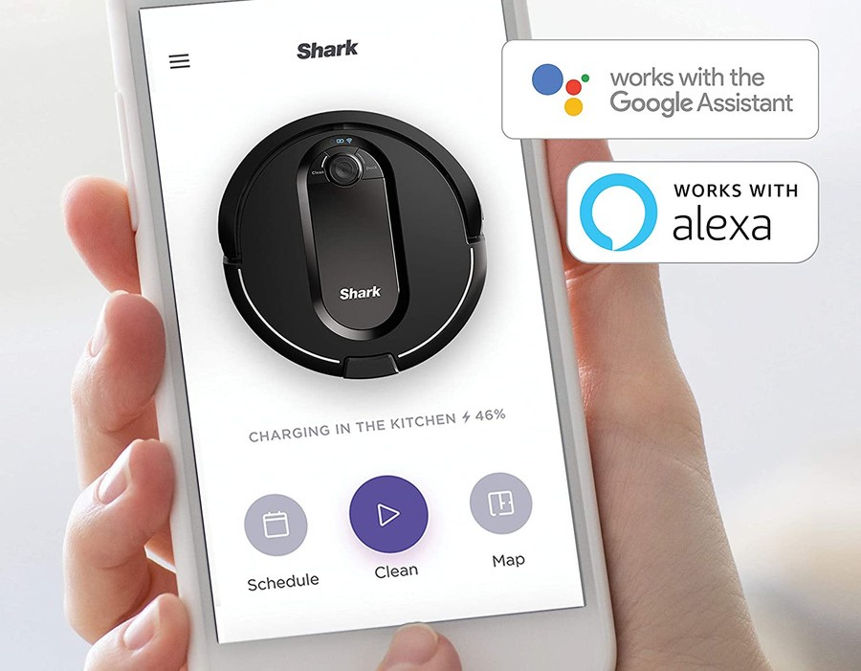
Intelligent Cleaning
SharkClean app Amazon Alexa Google Assistant

Slide 9
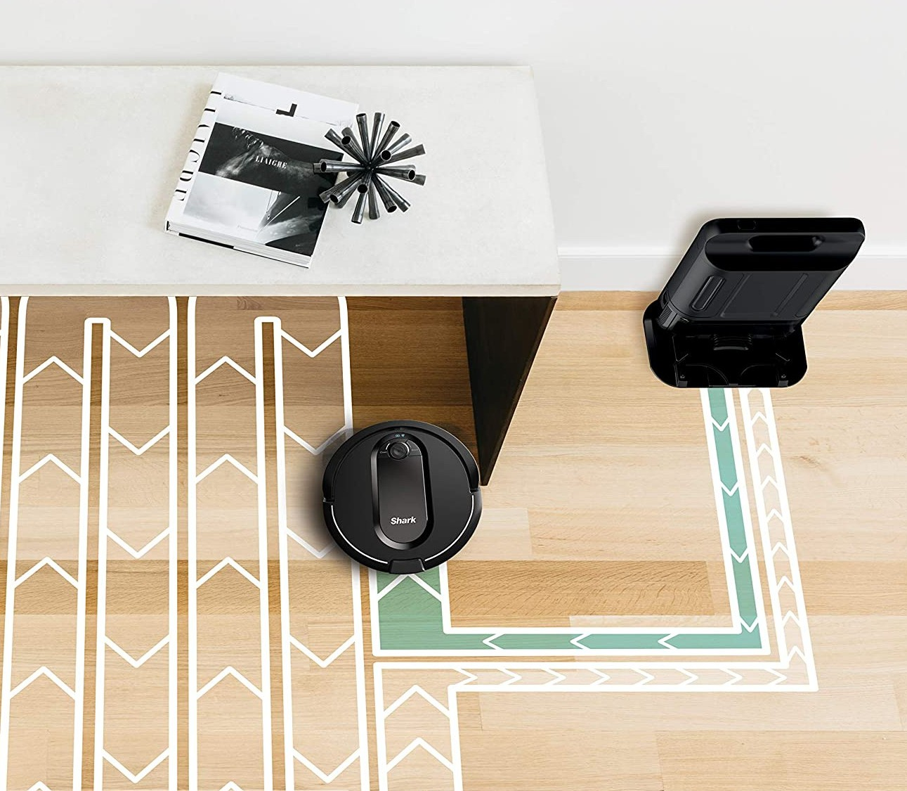
Recharge & Resume
Returns to Dock Charges
Leaves Docking Station Restarts at Last Location

Slide 10
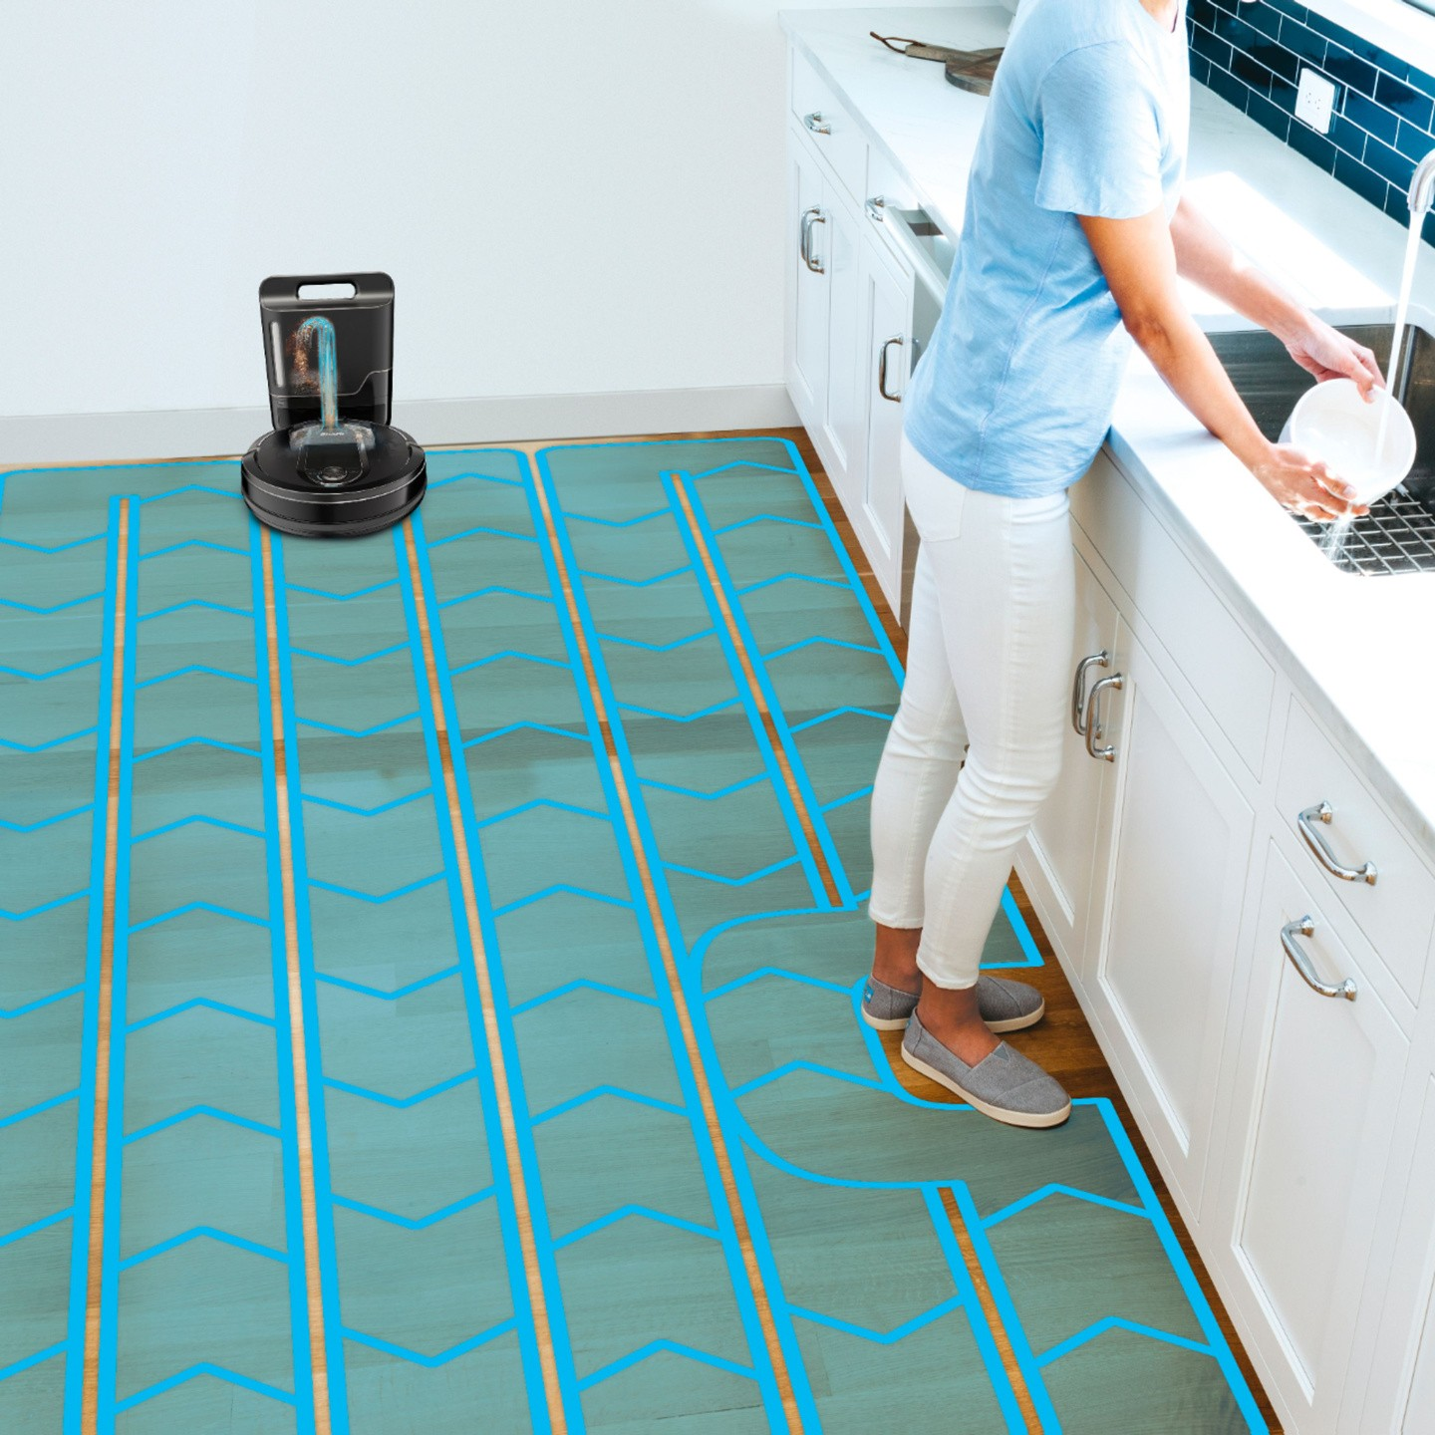

VACUMMING MADE EASY
Designed to Fit Your Life
Simplify Your Cleaning Easy to Use
Set it and Forget it Cleaner Home More Time for You

Slide 11
Customer Testimonials
"I love all of my shark products but this one hit the nail on the head! Super helpful with keeping floor clean. I have 2 large dogs and I set the schedule and it does the work. I have actually placed debris in front to watch it work. Great product and I will forever be a shark customer."
- Kari
(Reviewed on SharkClean.com)
"I bought a year ago and I’m so happy that I did. she work every day from the first day and in about 2 weeks she recognize the map. Ups one time you find a place for the dock don’t change or you need to re- map."
- Gaby
(Reviewed on SharkClean.com)
"This is worth every penny. Best vacuum purchase we ever made. Super good suction, love the self emptying base. Now if only Shark could make a robot mopping machine that actually is done right I would be in heaven."
- Jennie
(Reviewed on SharkClean.com)

Slide 12
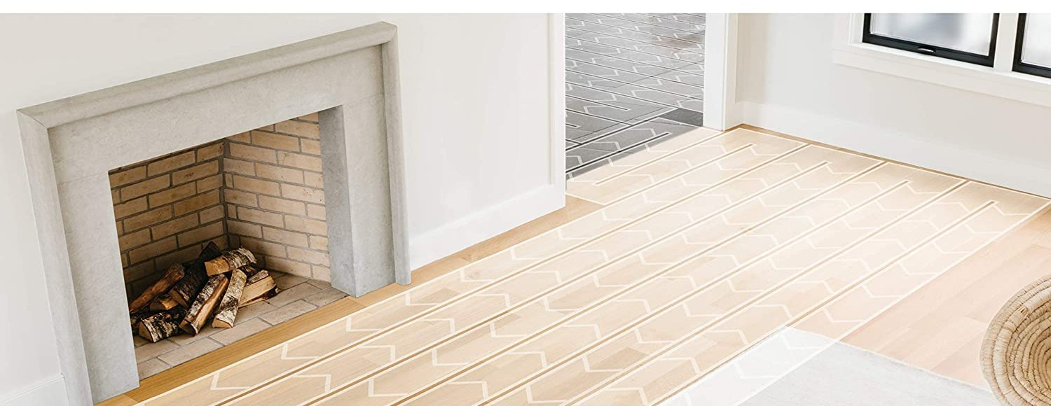

Simple Solution for Smarter Cleaning

