Slide 1
Sara Johnson
Principles of Advertising
Fall 2018
Notes:
To change the image on this slide, select the picture and delete it. Then click the Pictures icon in the placeholder to insert your own image.

Slide 2
TARGET MARKET
Women ages 20-35, working, busy, with kids, interested in staying fit and active, mid-income to high-income level.
Active on social media
Willing to spend money
Interested in keeping up-to-date with the latest technology
Tech savvy
Always busy and wants to be able to relax and not think
Adventurous and active.
Older men and women ages 50-65, active, not very tech savvy but willing to learn if it is easy, low income level, but willing to invest in things to ensure they don’t need “help”.
Feeling like the are losing control
Has family who are concerned about their well-being.
Want to have technology that is easy to use
Adventurous and active.

Slide 3
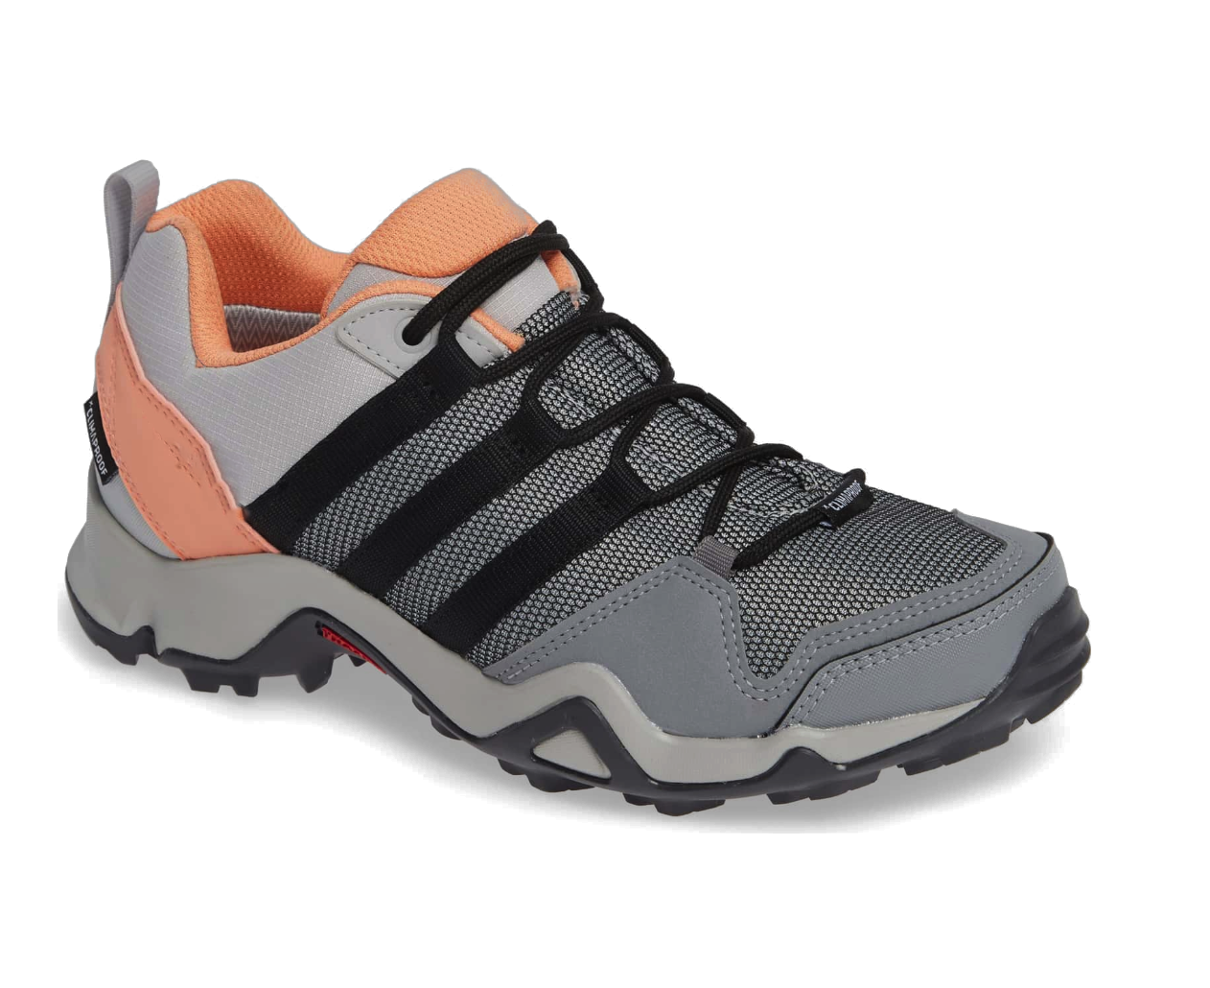
How to Reach the Target Market
Women 20-35
Social media
Digital Ads and Banners
Magazines
`Older Men and Women 50-65
Television
Billboards
AARP Online/Magazine
Enjoy the experience.
Let your shoes do the thinking.
Feeling lost? Don’t worry Wear-2 shoes will get you there!
This Photo by Unknown Author is licensed under CC BY-SA-NC
Enter in your destination and let the shoes get you there.
This Photo by Unknown Author is licensed under CC BY-NC-ND

Slide 4
Commercial Ideas
Commercial 1
Family Intervention
Be there, not here
Comedy: Mother won't take off her Wear-2 shoes
Commercial 2
Shoes in action
Let them do the thinking
COMEDY: Millennial who doesn't want to think. Wear-2 shoes think for her. Worth spending the money no need to think about what the phone is telling her. What millennial wants to have to think or work?
Commercial 3
Shoes in action
Always get there
Images of the shoes and relaxed jogger who can just go whatever way the Wear-2 shoes take her.

Slide 5
Decision: Commercial 3
Wear-2 shoes are meant to get you every where you want to be. Never miss a beat with these shoes and you will always get there.
Notes:
To change the image on this slide, select the picture and delete it. Then click the Pictures icon in the placeholder to insert your own image.

Slide 6
Script & 2 Soundtrack Options thoughts…planning...ideas…
Woman’s voice: Phone…check. Shoes…check. Destination…check.
-Break-
Narrator: Do you feel that?
-Break-
Narrator: That’s the feeling of comfort.
-Break-
Woman: With the Wear-2 shoes I just enter in my destination and let my shoes direct me where to go. Left or right? I never have to look at my phone. I just wait to feel which foot vibrates and enjoy the journey.
-Break-
Narrator: Want to get ahead in life?
-Break-
Woman: It’s not about where you go……It’s about how you get there.

Slide 7
Visual Concepts
Scene 1: Phone
Woman: Phone…check.

Slide 8
Visual Concepts
Scene 1: Tying laces
Scene 2: Running
This Photo by Unknown Author is licensed under CC BY
Woman: Shoes…check.
Woman: Destination…check.
This Photo by Unknown Author is licensed under CC BY-NC-ND

Slide 9
Visual Concepts
Scene 3: Shoes in action
Scene 4: Woman running
This Photo by Unknown Author is licensed under CC BY-NC-ND
Narrator: Just enter in your destination
And let your shoes direct you where to go.
This Photo by Unknown Author is licensed under CC BY-SA
Narrator: Left or right?

Slide 10
Visual Concepts
Scene 5: Entering destination into phone
Scene 6: Shoes image and vibration noise upon option to turn left or right
This Photo by Unknown Author is licensed under CC BY
This Photo by Unknown Author is licensed under CC BY-NC-ND
Narrator: You don’t need to check your phone.
Narrator: Your shoes will vibrate when it’s time to turn.

Slide 11
Visual Concepts
Scene 7: Shoes image
Scene 8: Logo
Narrator: Enjoy the journey.

Slide 12
MOCKUP CONCEPT FROM STORYBOARDS

Slide 13
Changes in script after photo shoot and onsite for filming
It seems like the woman needs to be in control in this situation. Is it best for the narrator to tell the benefits while the woman is relaxing during her journey?
The director, writer, producer, and marketing specialist think that the woman should make the first 2 statements and then let the narrator announce from there.
Overall, the target market wants to feel relaxed during this commercial. What do the shoes do and how relaxed is the woman who is running? They want to know if this is easy and then will research the product.
During editing is has been determined that the The Scott Holmes soundtrack is the most impactful for the commercial.

Slide 14
The Commercial – 30 seconds with music & graphics CLICK THE PLAY BUTTON (might be a slight delay)

